Slide 1

Nevada Office of Minority Health & Equity (NOMHE)
Program Manager Update
Tina Dortch, Program Manager
(08/17/2021)

Slide 2
NOMHE Impact Fatigued and Taxed Listening Session Series
What is the Minority Tax?
Minority Tax is the costly intersection BIPOC medical professionals experience between advocating for BIPOC patients/communities served and upholding the interests of profit driven medical institutions – often at the expense of their personal wellbeing and professional advancement
NOMHE’s Response to the Minority Tax?
Fatigued and Taxed Listening Sessions
Alliance Building, Redefining Value
Notes:
Mention Legislative Staff Connections
Bills being monitored in a living document
How Tracking System Serves NOMHE during Legislative Session
Memorializes integration of health equity within the legislative process (ASLR’s: Comments on behalf of Director’s Office or Health Equity Analysis; Embed supporting materials that should the bill pass, it will help in actioning the past intent.
Three Sections
OMHE
DHHS
Populations We Serve

Slide 3
NOMHE Impact Community Backpack Giveaway and Prevention Focused Health Fair (8/7/2021)
Purpose
Outcome
Reframing Outreach
Re-establishing Preventative Care
Recognition of COVID-19 as a Chronic Disease
20 Service Providers
1,150 Attendees
350 COVID-19 Tests administered in addition to COVID-19 Vaccines, back to school vaccines and the HPV vaccine
Results of Event Day Outreach Survey
Notes:
When speaking about NOMHE: Changes to the NRS could result in changes to the By-Laws
800 - Back to School Fair
- COIVD- Tests
## - COVID Vaccines

Slide 4
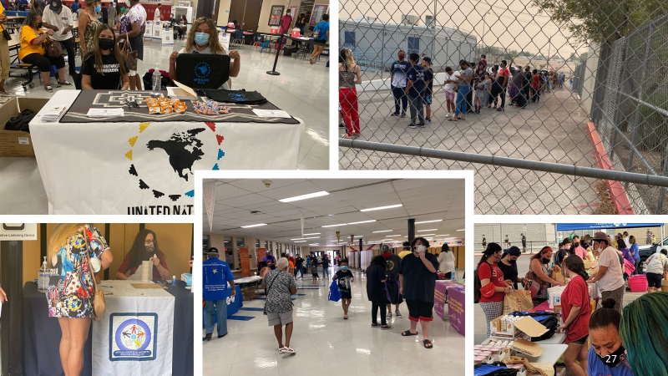

Slide 5
Capacity Building Actions CDC Health Disparity Grant
CDC GRANT PURPOSE / OUTCOMES:
reduce COVID-19-related health disparities,
improve and increase testing and contact tracing among populations at higher risk and that are underserved
improve capacity and service delivery of health and human service providing entities to prevent and control COVID-19 infection among populations at higher risk and that are underserved

Slide 6
Capacity Building Actions CDC Health Disparity Grant
NOMHE’s KEY DELIVERABLES / STAFFING RESPONSE:
Development of Health Equity Plan that reflects emergency responsiveness considerations, language access planning
Multi-sector coalition building and collaboration enhancements, specifically working with the Nevada Minority Health Equity Coalition
Policy changes and operational improvements within NOMHE and across DHHS service providing agencies, with a focus on health equity
Development and implementation of training on engaging at-risk and underserved populations.
Report on all activities and impacts

Slide 7
Capacity Building Actions CDC Health Disparity Grant
NOMHE’s Subawards:
University of Nevada, Las Vegas – The Minority Health Equity Coalition
Community Building
University of Nevada, Las Vegas – School of Public Health
Process Evaluation
University of Nevada, Reno – NV Public Health Training Center (affiliated with the new Larson Institute for Health Impact and Equity)
Training - Emphasis on HiAP and Sexual and Gender Minority populations
Social Entrepreneurs, Inc
Community Building – Diversity Equity & Inclusion Strategy Content; Policy and Procedure Manual with Emphasis on Workforce inclusion

Slide 8
Capacity Building Actions 81st Legislative Session – Equity Focused Bills
SB424
Senate Committee on Finance
Funds NOMHE staff person to assist Governor Office’s new Public Health Resource Office with review of state’s public health infrastructure.
SB341
Senator Pat Spearman
Kidney Disease Task Force; Promotes development of public/private partnerships; establishes Minority Health Equity Fund
SB390
Senate Committee on Health and Human Services
NOMHE appoints 6 persons to Advisory Committee for Resilient Nevada; requires input from NOMHE on Needs Assessment related to opioid misuse and distributing Opioid settlement
SB222
AB119
Senator Melanie Scheible
Assembly Woman Clara Thompson
NOMHE Advisory Committee to give input on the Maternal Mortality Review Committee’s Corrective Action Recommendations
NOMHE working with the Office of New Americans and The Minority Commission in order to identifying agency-level Diversity Liaisons and develop related protocols

Slide 9
9

